Slide 1
Pipelines in Python
Ordina

Slide 2
content
sudo dpkg -i abcd.deb
https://lms.godeploy.it/
Sudo kill -9 5135

Slide 3
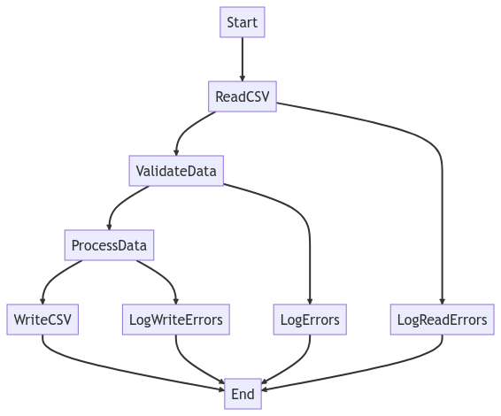
What is a data pipeline in Python?
A data pipeline with Python is a series of data processing steps that transform raw data into actionable insights. This includes the
Collect,
Clean up,
Validate and
Convert
of data to make it suitable for analysis and reporting. Data pipelines in Python can be simple and consist of a few steps - or they can be complex and include several steps and tools. Both are possible.

Slide 4
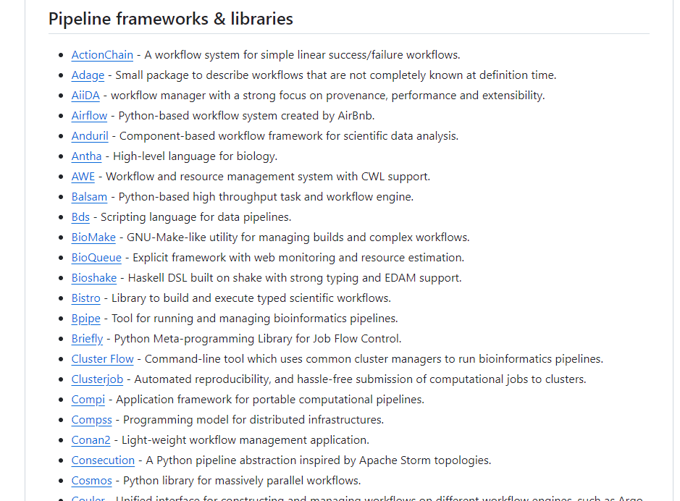
Different Pipeline toolkits & frameworks
Notes:
https://github.com/pditommaso/awesome-pipeline

Slide 5
Main pipeline frameworks
Python provides several frameworks for creating data pipelines, including Apache Airflow, Luigi, and Prefect. With these frameworks, you can easily create, schedule, and manage your data pipelines.
Apache Airflow: A powerful open source platform that allows you to create, plan and monitor workflows in Python.
Luigi: A Python module developed by Spotify that simplifies the construction of complex data pipelines.
Prefect: A modern data pipeline framework with a focus on simplicity, flexibility and scalability.

Slide 6
Steps in the pipeline
5 steps for data processing :
Define the data sources: Identify where the data comes from and how it should be collected.
Clean and validate data: Use Python libraries such as Pandas and NumPy to clean, validate and prepare the data.
Transform and enrich data: Use Data transformations and enrichments to improve the quality of the data for analysis.
Store the processed data: Save the processed data in a suitable storage system, such as a database or a Cloud storage.
Analyze and visualize data: Use Python libraries such as Matplotlib, Seaborn and Plotly for Data visualization and analysis.

Slide 7
Data Pipeline and ETL Pipeline: The difference
Often the terms Data Pipeline and ETL Pipeline (Extract-Transform-Load) are used synonymously - but this is wrong.
ETL pipelines represent a subcategory of data pipelines. 3 characteristics show this particularly clearly:
ETL pipelines follow a specific sequence. Here, the data is extracted, transformed and stored in a data repository. However, there are also other ways to design data pipelines. In particular, with the introduction of cloudnative tools, the circumstances have changed. In these cases, data is ingested first and then loaded into the cloud data warehouse. Only then are transformations performed.
ETL processes tend to involve batch processing but as already mentioned, the scope of application of data lines is more extensive. They can also integrate the processing of data streams.
Ultimately, although rather rare, it is not mandatory that data pipelines as a whole system perform data transformations as in ETL pipelines. Nevertheless, there is hardly any data pipeline that does not employ data transformations to facilitate the data analysis process.

Slide 8
Extract-Load-Transform for the Data Lake
In recent years, the ELT process as an alternative variant to the ETL process established.
In the ETL process, the data is first prepared, but this can lead to some information being lost. Originally, this process comes from the data warehousing area, where structured information is of great importance.
This contrasts with the ELT process, where data is first transferred to another infrastructure before being processed. This preserves as much of the original form and content as possible, which is especially important in the field of data science to train accurate machine learning models.
The ELT process is used primarily in the area of Big Data and Data Lakes, as unstructured data can also be processed effectively in this way. ETL and ELT are also generally referred to as "Data Ingestion", which includes data ingestion.

Slide 9
tips
Here are 4 helpful tips to improve your data pipeline:
Modularize your code: Break your pipeline into smaller, reusable components to make it easier to maintain and debug.
Use version control: Track changes to your pipeline code and data using tools such as Git and GitHub.
Automate testing: Implement automated Teststo ensure the accuracy and integrity of your data pipeline.
Monitor and log: Set up monitoring and logging systems to track the performance and health of your data pipeline.

Slide 10
Pipeline libraries for data processing
Python provides a rich ecosystem of libraries for building data processing pipelines. Here are some important libraries for data manipulation and analysis in Python:
Pandas
A powerful library for data manipulation and analysis. With Pandas, data can be imported in various formats such as CSV, Excel or SQL tables and saved as data frames (DataFrame). Pandas also offers many functions for data manipulation such as filtering, grouping and aggregation.
NumPy
A library for numerical calculations in Python. NumPy offers a variety of functions for numerical calculations such as linear algebra, Fourier transformation and random number generation. NumPy is also the basis for many other libraries used in data science.

Slide 11
Pipeline libraries for data processing
Dask
A parallel computing library for large-scale data processing. With Dask you can process large data sets in parallel on a cluster of computers. Dask also offers functions for storing and analyzing large data sets in distributed systems.
Scikit-learn
A library for machine learning and data mining in Python. Scikit-learn offers a variety of machine learning algorithms such as regression, classification, clustering and dimensionality reduction. Scikit-learn also offers functions for data modeling, evaluation and selection.
Extract, transform, load (ETL) is a common approach to creating data pipelines. Python is an excellent choice for creating ETL pipelines because of its extensive library support and ease of use. Some popular Python libraries for ETL are Pandas, SQLAlchemy, and PySpark.

Slide 12
Create Your First ETL Pipeline with Python
Notes:
https://anujsyal.com/create-your-first-etl-pipeline-with-python

Slide 13

Apache airflow
Notes:
https://airflow.apache.org/docs/apache-airflow/stable/howto/index.html
https://github.com/ananthdurai/airflow-training
https://airflow.apache.org/docs/apache-airflow/stable

Slide 14
What is Airflow?
Apache Airflow™ is an open-source platform for developing, scheduling, and monitoring batch-oriented workflows. Airflow’s extensible Python framework enables you to build workflows connecting with virtually any technology. A web interface helps manage the state of your workflows. Airflow is deployable in many ways, varying from a single process on your laptop to a distributed setup to support even the biggest workflows.

Slide 15
Workflows as code
The main characteristic of Airflow workflows is that all workflows are defined in Python code. “Workflows as code” serves several purposes:
Dynamic: Airflow pipelines are configured as Python code, allowing for dynamic pipeline generation.
Extensible: The Airflow™ framework contains operators to connect with numerous technologies. All Airflow components are extensible to easily adjust to your environment.
Flexible: Workflow parameterization is built-in leveraging the Jinja templating engine.

Slide 16
from datetime import datetime
from airflow import DAG
from airflow.decorators import task
from airflow.operators.bash import BashOperator
# A DAG represents a workflow, a collection of tasks
with DAG(dag_id="demo", start_date=datetime(2022, 1, 1), schedule="0 0 * * *") as dag:
# Tasks are represented as operators
hello = BashOperator(task_id="hello", bash_command="echo hello")
@task()
def airflow():
print("airflow")
# Set dependencies between tasks
hello >> airflow()

Slide 17
Here you see:
A DAG named “demo”, starting on Jan 1st 2022 and running once a day. A DAG is Airflow’s representation of a workflow.
Two tasks, a BashOperator running a Bash script and a Python function defined using the @task decorator
>> between the tasks defines a dependency and controls in which order the tasks will be executed
Airflow evaluates this script and executes the tasks at the set interval and in the defined order. The status of the “demo” DAG is visible in the web interface:

Slide 18
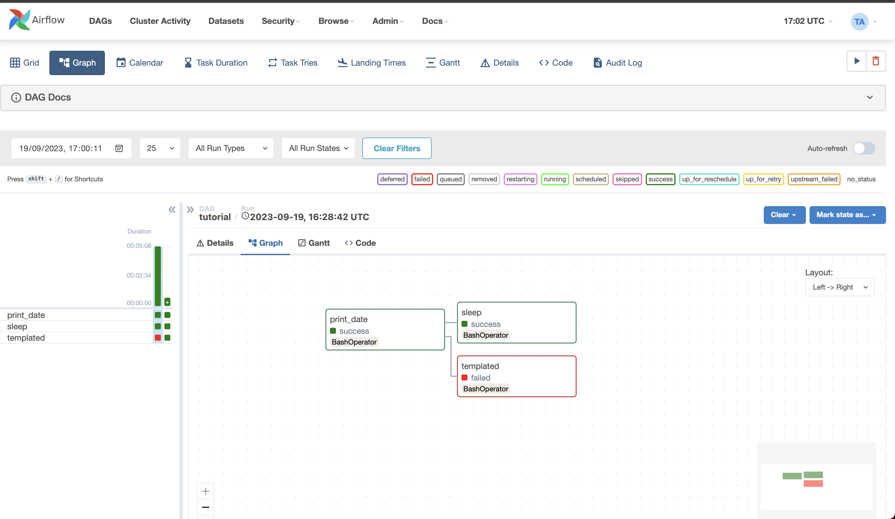

Slide 19
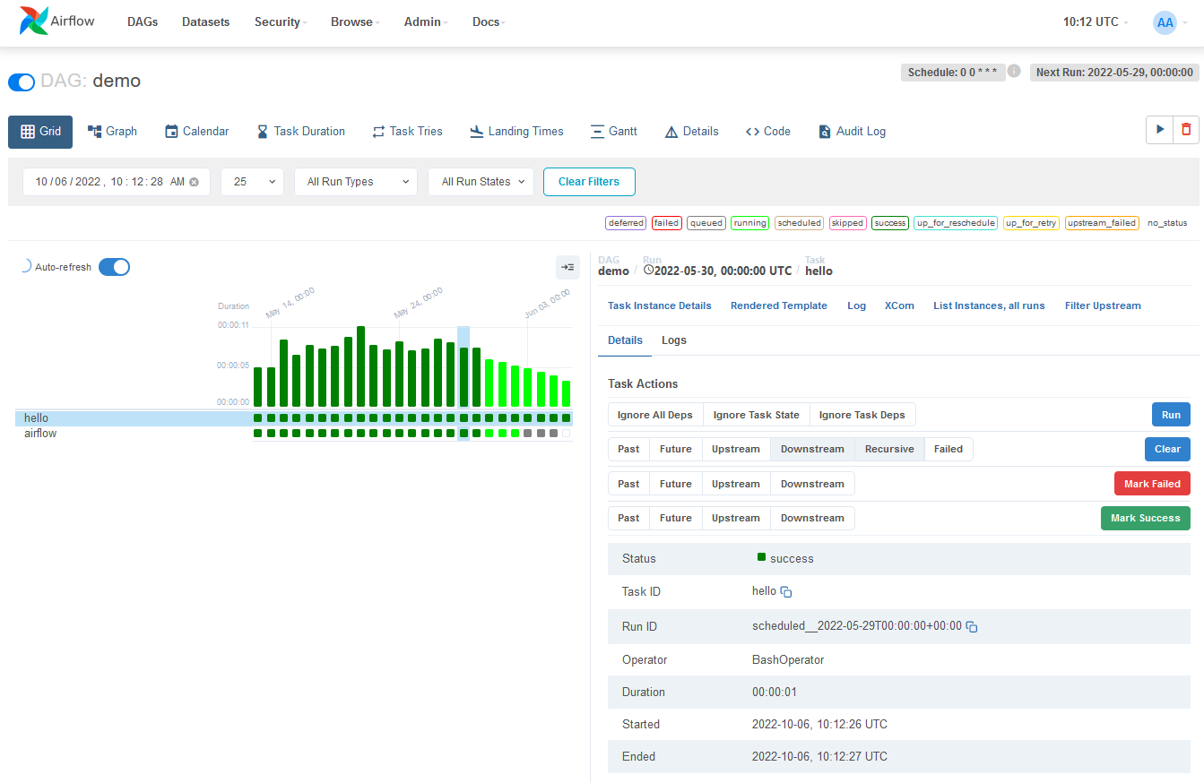

Slide 20
Why Airflow™?
Airflow™ is a batch workflow orchestration platform. The Airflow framework contains operators to connect with many technologies and is easily extensible to connect with a new technology. If your workflows have a clear start and end, and run at regular intervals, they can be programmed as an Airflow DAG.
If you prefer coding over clicking, Airflow is the tool for you. Workflows are defined as Python code which means:
Workflows can be stored in version control so that you can roll back to previous versions
Workflows can be developed by multiple people simultaneously
Tests can be written to validate functionality
Components are extensible and you can build on a wide collection of existing components

Slide 21
Rich scheduling and execution semantics enable you to easily define complex pipelines, running at regular intervals. Backfilling allows you to (re-)run pipelines on historical data after making changes to your logic. And the ability to rerun partial pipelines after resolving an error helps maximize efficiency.
Airflow’s user interface provides:
In-depth views of two things:
Pipelines
Tasks
Overview of your pipelines over time
From the interface, you can inspect logs and manage tasks, for example retrying a task in case of failure.
The open-source nature of Airflow ensures you work on components developed, tested, and used by many other companies around the world. In the active community you can find plenty of helpful resources in the form of blog posts, articles, conferences, books, and more. You can connect with other peers via several channels such as Slack and mailing lists.
Airflow as a Platform is highly customizable. By utilizing Public Interface of Airflow you can extend and customize almost every aspect of Airflow

Slide 22
Why not Airflow™?
Airflow™ was built for finite batch workflows. While the CLI and REST API do allow triggering workflows, Airflow was not built for infinitely running event-based workflows. Airflow is not a streaming solution. However, a streaming system such as Apache Kafka is often seen working together with Apache Airflow. Kafka can be used for ingestion and processing in real-time, event data is written to a storage location, and Airflow periodically starts a workflow processing a batch of data.
If you prefer clicking over coding, Airflow is probably not the right solution. The web interface aims to make managing workflows as easy as possible and the Airflow framework is continuously improved to make the developer experience as smooth as possible. However, the philosophy of Airflow is to define workflows as code so coding will always be required.

Slide 23
sudo apt-get update
sudo apt-get install python3-pip
sudo nano /etc/profile
export PATH="MYPATH:$PATH“
^X, Y, enter
pip install Flask-Session==0.5.0

Slide 24
Fundamental Concepts
It’s a DAG definition file
One thing to wrap your head around (it may not be very intuitive for everyone at first) is that this Airflow Python script is really just a configuration file specifying the DAG’s structure as code. The actual tasks defined here will run in a different context from the context of this script. Different tasks run on different workers at different points in time, which means that this script cannot be used to cross communicate between tasks. Note that for this purpose we have a more advanced feature called XComs.
People sometimes think of the DAG definition file as a place where they can do some actual data processing - that is not the case at all! The script’s purpose is to define a DAG object. It needs to evaluate quickly (seconds, not minutes) since the scheduler will execute it periodically to reflect the changes if any.

Slide 25
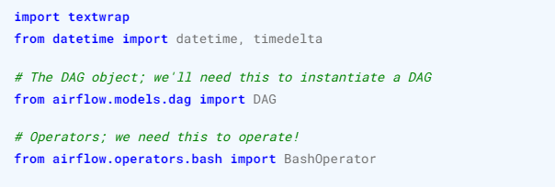
Importing Modules
An Airflow pipeline is just a Python script that happens to define an Airflow DAG object. Let’s start by importing the libraries we will need.
Notes:
https://airflow.apache.org/docs/apache-airflow/stable/administration-and-deployment/modules_management.html

Slide 26
Default Arguments
We’re about to create a DAG and some tasks, and we have the choice to explicitly pass a set of arguments to each task’s constructor (which would become redundant), or (better!) we can define a dictionary of default parameters that we can use when creating tasks.
Also, note that you could easily define different sets of arguments that would serve different purposes. An example of that would be to have different settings between a production and development environment
Notes:
https://airflow.apache.org/docs/apache-airflow/stable/_api/airflow/models/baseoperator/index.html#airflow.models.baseoperator.BaseOperator

Slide 27
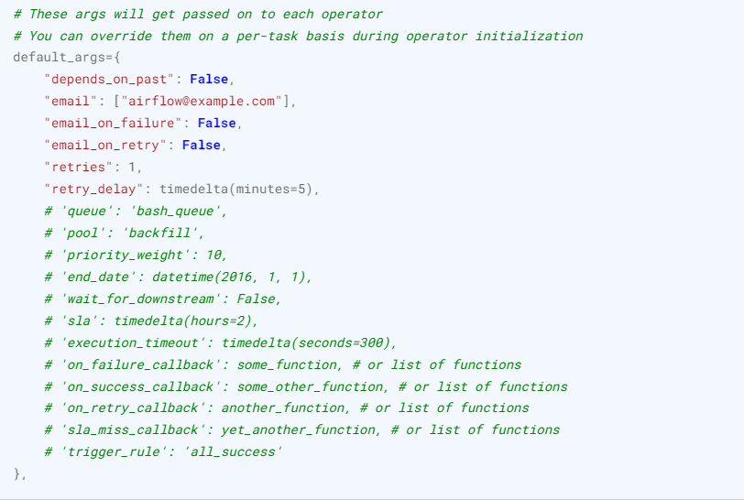

Slide 28
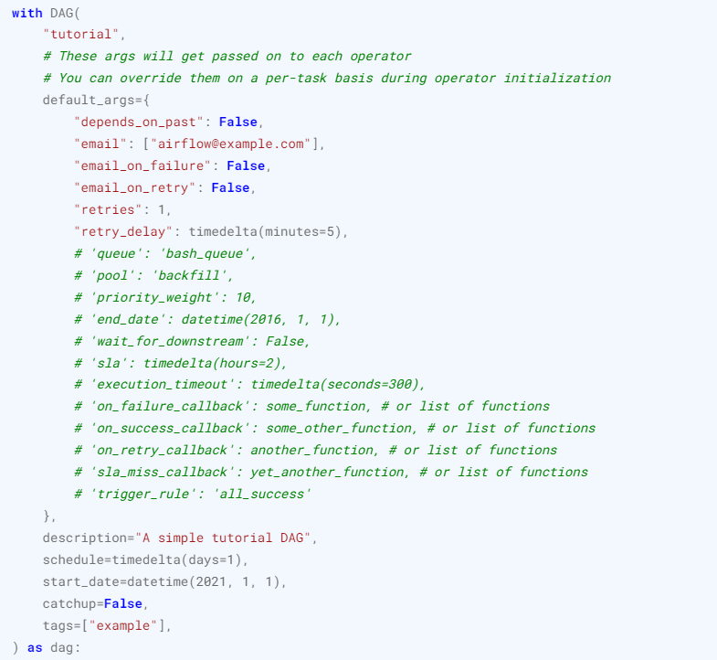
Instantiate a DAG

Slide 29
Operators
An operator defines a unit of work for Airflow to complete. Using operators is the classic approach to defining work in Airflow. For some use cases, it’s better to use the TaskFlow API to define work in a Pythonic context as described in Working with TaskFlow. For now, using operators helps to visualize task dependencies in our DAG code.
All operators inherit from the BaseOperator, which includes all of the required arguments for running work in Airflow. From here, each operator includes unique arguments for the type of work it’s completing. Some of the most popular operators are the PythonOperator, the BashOperator, and the KubernetesPodOperator.
Airflow completes work based on the arguments you pass to your operators. In this tutorial, we use the BashOperator to run a few bash scripts.

Slide 30
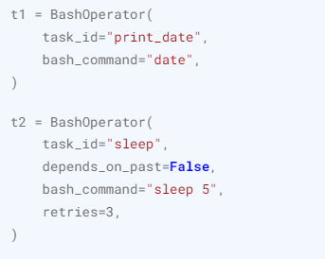
Tasks
To use an operator in a DAG, you have to instantiate it as a task. Tasks determine how to execute your operator’s work within the context of a DAG.
In the following example, we instantiate the BashOperator as two separate tasks in order to run two separate bash scripts. The first argument for each instantiation, task_id, acts as a unique identifier for the task.

Slide 31
Notice how we pass a mix of operator specific arguments (bash_command) and an argument common to all operators (retries) inherited from BaseOperator to the operator’s constructor. This is simpler than passing every argument for every constructor call. Also, notice that in the second task we override the retries parameter with 3.
The precedence rules for a task are as follows:
Explicitly passed arguments
Values that exist in the default_args dictionary
The operator’s default value, if one exists
A task must include or inherit the arguments task_id and owner, otherwise Airflow will raise an exception. A fresh install of Airflow will have a default value of ‘airflow’ set for owner, so you only really need to worry about ensuring task_id has a value

Slide 32
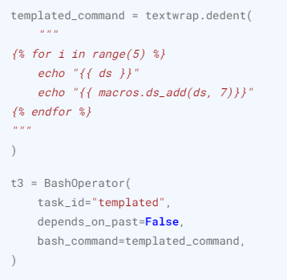
Templating with Jinja
Airflow leverages the power of Jinja Templating and provides the pipeline author with a set of built-in parameters and macros. Airflow also provides hooks for the pipeline author to define their own parameters, macros and templates.
This tutorial barely scratches the surface of what you can do with templating in Airflow, but the goal of this section is to let you know this feature exists, get you familiar with double curly brackets, and point to the most common template variable: {{ ds }} (today’s “date stamp”).
Notes:
https://airflow.apache.org/docs/apache-airflow/stable/templates-ref.html#templates-ref

Slide 33
Notice that the templated_command contains code logic in {% %} blocks, references parameters like {{ ds }}, and calls a function as in {{ macros.ds_add(ds, 7)}}.
Files can also be passed to the bash_command argument, like bash_command='templated_command.sh', where the file location is relative to the directory containing the pipeline file (tutorial.py in this case). This may be desirable for many reasons, like separating your script’s logic and pipeline code, allowing for proper code highlighting in files composed in different languages, and general flexibility in structuring pipelines. It is also possible to define your template_searchpath as pointing to any folder locations in the DAG constructor call.
Using that same DAG constructor call, it is possible to define user_defined_macros which allow you to specify your own variables. For example, passing dict(foo='bar') to this argument allows you to use {{ foo }} in your templates. Moreover, specifying user_defined_filters allows you to register your own filters. For example, passing dict(hello=lambda name: 'Hello %s' % name) to this argument allows you to use {{ 'world' | hello }} in your templates

Slide 34
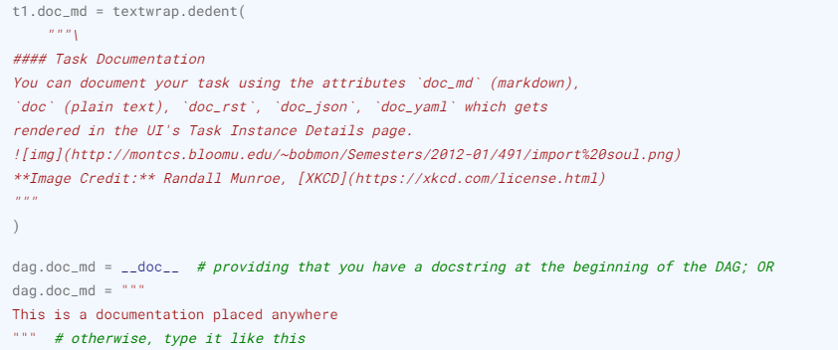
Adding DAG and Tasks documentation
We can add documentation for DAG or each single task. DAG documentation only supports markdown so far, while task documentation supports plain text, markdown, reStructuredText, json, and yaml. The DAG documentation can be written as a doc string at the beginning of the DAG file (recommended), or anywhere else in the file. Below you can find some examples on how to implement task and DAG docs, as well as screenshots:

Slide 35
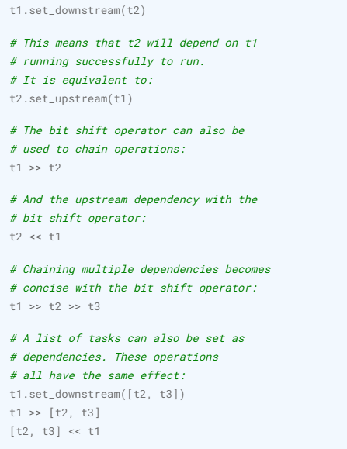
Setting up Dependencies
We have tasks t1, t2 and t3 that do not depend on each other. Here’s a few ways you can define dependencies between them
Note that when executing your script, Airflow will raise exceptions when it finds cycles in your DAG or when a dependency is referenced more than once

Slide 36
Using time zones
Creating a time zone aware DAG is quite simple. Just make sure to supply a time zone aware dates using pendulum. Don’t try to use standard library timezone as they are known to have limitations and we deliberately disallow using them in DAGs.

Slide 37
Testing
Time to run some tests. First, let’s make sure the pipeline is parsed successfully.
Let’s assume we are saving the code from the previous step in tutorial.py in the DAGs folder referenced in your airflow.cfg. The default location for your DAGs is ~/airflow/dags.
python ~/airflow/dags/tutorial.py
If the script does not raise an exception it means that you have not done anything horribly wrong, and that your Airflow environment is somewhat sound

Slide 38
Command Line Metadata Validation
Let’s run a few commands to validate this script further.
source airflow_env/bin/activate
# initialize the database tables
airflow db migrate
# print the list of active DAGs
airflow dags list
# prints the list of tasks in the "tutorial" DAG
airflow tasks list tutorial
# prints the hierarchy of tasks in the "tutorial" DAG
airflow tasks list tutorial --tree

Slide 39
Testing
Let’s test by running the actual task instances for a specific date. The date specified in this context is called the logical date (also called execution date for historical reasons), which simulates the scheduler running your task or DAG for a specific date and time, even though it physically will run now (or as soon as its dependencies are met).
We said the scheduler runs your task for a specific date and time, not at. This is because each run of a DAG conceptually represents not a specific date and time, but an interval between two times, called a data interval. A DAG run’s logical date is the start of its data interval.

Slide 40
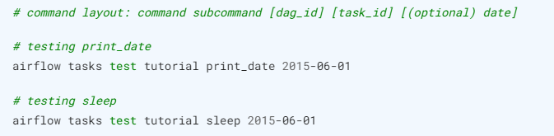

testing
Now remember what we did with templating earlier? See how this template gets rendered and executed by running this command:
This should result in displaying a verbose log of events and ultimately running your bash command and printing the result.

Slide 41
testing
Note that the airflow tasks test command runs task instances locally, outputs their log to stdout (on screen), does not bother with dependencies, and does not communicate state (running, success, failed, …) to the database. It simply allows testing a single task instance.
The same applies to airflow dags test, but on a DAG level. It performs a single DAG run of the given DAG id. While it does take task dependencies into account, no state is registered in the database. It is convenient for locally testing a full run of your DAG, given that e.g. if one of your tasks expects data at some location, it is available

Slide 42
backfill
Everything looks like it’s running fine so let’s run a backfill. backfill will respect your dependencies, emit logs into files and talk to the database to record status. If you do have a webserver up, you will be able to track the progress. airflow webserver will start a web server if you are interested in tracking the progress visually as your backfill progresses.
Note that if you use depends_on_past=True, individual task instances will depend on the success of their previous task instance (that is, previous according to the logical date). Task instances with their logical dates equal to start_date will disregard this dependency because there would be no past task instances created for them.
You may also want to consider wait_for_downstream=True when using depends_on_past=True. While depends_on_past=True causes a task instance to depend on the success of its previous task_instance, wait_for_downstream=True will cause a task instance to also wait for all task instances immediately downstream of the previous task instance to succeed.

Slide 43
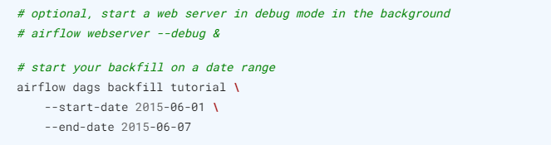
backfill
The date range in this context is a start_date and optionally an end_date, which are used to populate the run schedule with task instances from this DAG.

Slide 44
Taskflow api
What is the difference between DAGs written using the traditional paradigm and those written using the TaskFlow API in Apache Airflow?

Slide 45
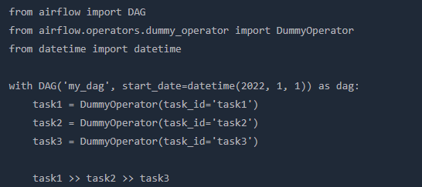
Taskflow vs classic
In Apache Airflow, a Directed Acyclic Graph (DAG) is a collection of tasks that run with a specified dependency structure. The traditional way of writing these DAGs involves defining each task and its dependencies separately.
For example, a simple traditional DAG could look like this:
In this example, each task is an instance of DummyOperator and dependencies are defined using the bitshift operators.

Slide 46
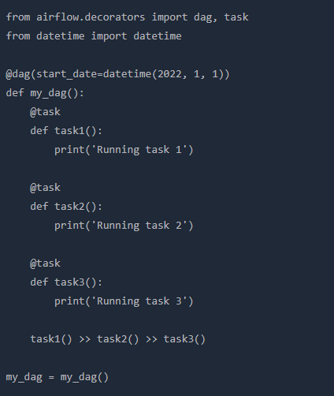
Taskflow vs classic
On the other hand, the TaskFlow API, introduced in Airflow 2.0, allows for a more pythonic way of defining tasks and their dependencies using python functions. Each function represents a task and the dependencies are defined by the function calls.
Here's how the same DAG would look using the TaskFlow API:

Slide 47
Taskflow vs classic
In this example, each task is a python function decorated with the @task decorator and dependencies are defined by the function calls.
The TaskFlow API provides several advantages over the traditional paradigm:
Simplicity: Tasks and dependencies are defined using standard python functions and function calls, making the code easier to write and understand.
Flexibility: Since tasks are just python functions, they can accept arguments and return values, allowing for more complex workflows.
Integration with XCom: The TaskFlow API automatically handles pushing and pulling of XComs (cross-communication), which are used to share data between tasks.
Notes:
https://realpython.com/python-kwargs-and-args/

Slide 49
The 6 Steps of ETL Process Using Airflow with Example and Exercise
https://tegardp.medium.com/the-6-step-etl-process-using-airflow-with-example-and-exercise-db46715a61f0
About The Project
Prerequisite
Basic knowledge of Python, installing packages, and virtual environment.
Basic knowledge of Airflow
Project Overview
Perform ETL from multiple data sources and store it to a single data source.
You can go to my GitHub profile to see the source code and the final project.

Slide 50

Luigi
Notes:
https://www.integrate.io/blog/airflow-vs-luigi/
https://medium.com/big-data-processing/getting-started-with-luigi-what-why-how-f8e639a1f2a5

Slide 51
Luigi is a workflow management system to launch a group of tasks with defined dependencies efficiently. It is a Python based API that Spotify® developed to build and execute pipelines. Developers can use it to create workflows with any external jobs written in R or Scala, or Spark. Luigi enables complex data pipelines for batch jobs, dependency resolution, workflow management, pipeline visualization, handling failures, command line integration, and more.
It is easy to learn, and a strong community supports regular development. Some of the features offered by Luigi are:
Ease the pipeline building
Separation of concerns
Comment event and failure handling
Integration of task with other eco-system jobs such as Spark

Slide 52
Install Luigi
We need to have Python 3 for the latest versions since it is written in Python. As you guessed, we will use the pip to install the Luigi on the machine.
pip install luigi
But as I always recommend, we should create a virtual environment. So we will create the virtual environment, enable it, and install the Luigi package.
python -m venv luigienv
source luigienv/bin/activate
pip install luigi

Slide 53
Luigi Pipeline components
Luigi doesn’t use DAG compared to other Airflow; instead, Luigi pipeline has two building blocks, Task and Target. A task is like a transformation or performing an operation that generates a target, such as an output file. Targets are both the results of a task and the input for the next task.
Tasks are the basic unit of work in the pipeline. It can also require another task to create a dependency, similar to a DAG. Each task generates the output targets, which are leveraged by the other tasks downstream. A task is considered complete only if its target exists.
A target could be the final output or intermediary output for other tasks to consume to produce the final result. For example, it can be a file on the file system or a database entry.

Slide 54
tasks
Tasks are developed using the Task class in Luigi. It has three essential methods
Requires: to specify the dependencies on the other task
Run: what is the business logic or different operations that need to be performed
Output: defines the output or where to store the output

Slide 55
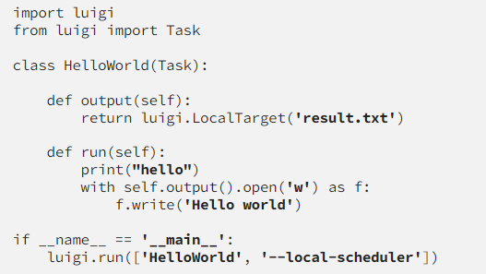
Writing your first pipeline
Task is the base class for all the tasks in the luigi. we define the target of the task through the output method on the task class. Following is the simple hello world extending the luigi task
Notes:
import luigi from luigi import Task class HelloWorld(Task): def output(self): return luigi.LocalTarget('result.txt') def run(self): print("hello") with self.output().open('w') as f: f.write('Hello world') if __name__ == '__main__': luigi.run(['HelloWorld', '--local-scheduler'])

Slide 56
Writing your first pipeline
The run method is the core where all the business logic or operations happen within a Luigi class, while output is used to send the data. Currently, it will write the hello world to a local file. So, the run method is doing the actual work, processing, and writing the results to the target.
Finally, we have run the Luigi pipeline from the main program. But, of course, you can run it from your IDE or the command line as well.
luigi --local-scheduler HelloWorld --module file_name TaskName
Luigi run needs to know which pipeline to run and where to run. We said that we want to run the hello world pipeline on the local system.-local-scheduler indicates that you want to run this task locally i.e., without connecting to luigi server

Slide 57
Writing a pipeline with multiple tasks
Now we know how to create a pipeline in the Luigi, we will create another example pipeline based on the Luigi documentation. This example has two tasks, and one is generating the words while the second task is counting the letters. But, first, let’s have a look at the code.

Slide 58
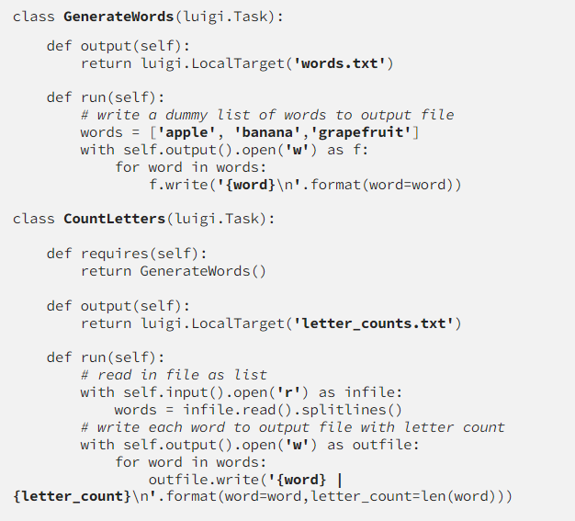
Notes:
class GenerateWords(luigi.Task): def output(self): return luigi.LocalTarget('words.txt') def run(self): # write a dummy list of words to output file﻿ words = ['apple', 'banana','grapefruit'] with self.output().open('w') as f: for word in words: f.write('{word}\n'.format(word=word)) class CountLetters(luigi.Task): def requires(self): return GenerateWords() def output(self): return luigi.LocalTarget('letter_counts.txt') def run(self): # read in file as list﻿ with self.input().open('r') as infile: words = infile.read().splitlines() # write each word to output file with letter count﻿ with self.output().open('w') as outfile: for word in words: outfile.write('{word} | {letter_count}\n'.format(word=word,letter_count=len(word)))

Slide 59
Writing a pipeline with multiple tasks
So the CountLetters is the primary task depending on the GenerateWords Task. So, first, GenerateWords() will be executed, which doesn’t have any dependency. It generates a target of a text file, words.txt. CountLetters() starts its execution while reading the input from self.input() which represents the targets specified in the required method. It reads all the input and counts the letters, and writes to a target of letter_counts.txt

Slide 60
Luigi pipelines continued
Luigi tasks have unique names, and they are atomic. Also, tasks are idempotent — which means running them, again and again, should produce the same result. Furthermore, Luigi’s tasks are processing checkpoints because it marks the completion of a stage in the pipeline. If the pipeline fails, it will continue where it left off instead of starting from scratch.
So, If you want to execute the task again, the output file for the task needs to be removed. Otherwise, Luigi will not rerun the task assuming that the last execution has been successful.
In the last article, we created a virtual environment and ran our hello world pipeline. Now we will use the same environment and build a few more pipelines with varying dependencies, sequences, and parallelism.

Slide 61
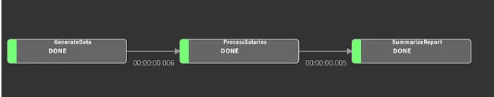
Sequential Pipelines
So, we will create dummy employee datasets and generate different analytical reports, such as counting the total salary per employee or how much the company pays to all the employees. The pipeline will have three stages, Generate data, Process Salaries, and then Generate summary reports. (It could be simpler, but I have added multiple stages for learning purposes.)

Slide 62
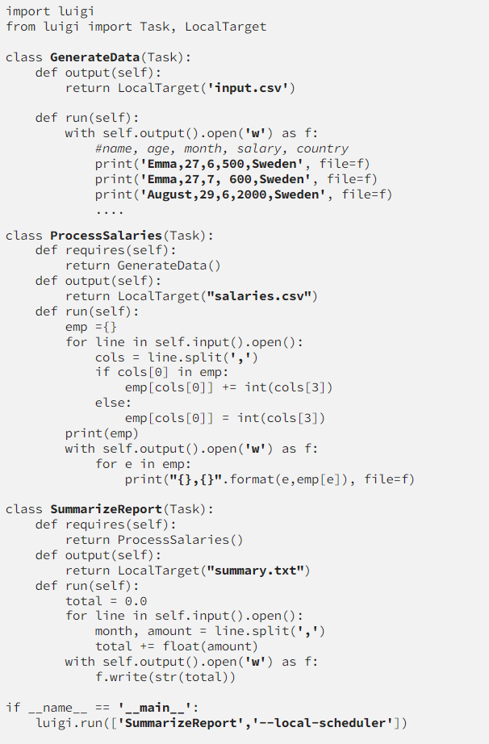
Notes:
import luigi from luigi import Task, LocalTarget class GenerateData(Task): def output(self): return LocalTarget('input.csv') def run(self): with self.output().open('w') as f: #name, age, month, salary, country print('Emma,27,6,500,Sweden', file=f) print('Emma,27,7, 600,Sweden', file=f) print('August,29,6,2000,Sweden', file=f) ....class ProcessSalaries(Task): def requires(self): return GenerateData() def output(self): return LocalTarget("salaries.csv") def run(self): emp ={} for line in self.input().open(): cols = line.split(',') if cols[0] in emp: emp[cols[0]] += int(cols[3]) else: emp[cols[0]] = int(cols[3]) print(emp) with self.output().open('w') as f: for e in emp: print("{},{}".format(e,emp[e]), file=f) class SummarizeReport(Task): def requires(self): return ProcessSalaries() def output(self): return LocalTarget("summary.txt") def run(self): total = 0.0 for line in self.input().open(): month, amount = line.split(',') total += float(amount) with self.output().open('w') as f: f.write(str(total)) if __name__ == '__main__': luigi.run(['SummarizeReport','--local-scheduler'])

Slide 63
Code explained
As you can see in the above code listing, Generate Data has no dependencies, creating input.csv as an output file. Next, Process salaries depend on Generate Data task because it reads from the input.csv. It sums all the salaries for each employee and stores it into a salaries.csv file. Finally, the summary report task summarizes all the employees’ salaries and stores them in the summary.txt file.

Slide 64
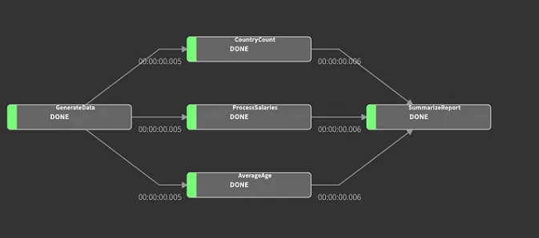
Parallel Pipelines
Let’s say we have a requirement to see the total salary paid to each employee, the number of employees for each country, and the average age of all the employees. In this case, we don’t need a sequential pipeline, but we can execute all the tasks in parallel. So, we will design our pipeline as follows.

Slide 65
As you can see in fig 2, we have to Generate an input task feeding the data to three tasks, which are running in parallel, and their output is consumed by the Summarise report, which is similar to a dashboard for a company.
Generate Data and process salaries will have the same code, but for the other two tasks, we have the code as follows.

Slide 66
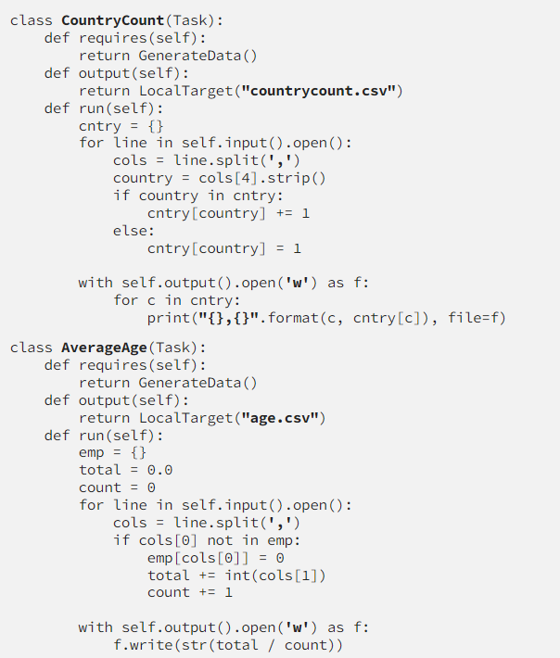
Notes:
class CountryCount(Task): def requires(self): return GenerateData() def output(self): return LocalTarget("countrycount.csv") def run(self): cntry = {} for line in self.input().open(): cols = line.split(',') country = cols[4].strip() if country in cntry: cntry[country] += 1 else: cntry[country] = 1 with self.output().open('w') as f: for c in cntry: print("{},{}".format(c, cntry[c]), file=f)class AverageAge(Task): def requires(self): return GenerateData() def output(self): return LocalTarget("age.csv") def run(self): emp = {} total = 0.0 count = 0 for line in self.input().open(): cols = line.split(',') if cols[0] not in emp: emp[cols[0]] = 0 total += int(cols[1]) count += 1 with self.output().open('w') as f: f.write(str(total / count))

Slide 67
So, now we have all three different tasks up and running. The only update is the summarised tasks, where require method will have three tasks. Additionally, since we will have more inputs to the tasks, we will use indexing while accessing the Task inputs. So self.input() will be updated to self.input()[0] as per the order in the require method. Following is the updated summarised task code.

Slide 68
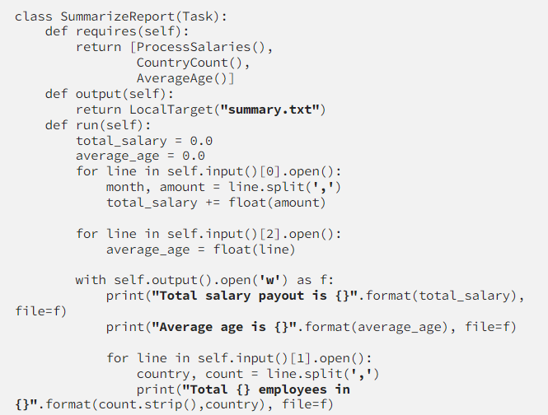
Finally, instead of only writing to the files, we can write to S3Target or a database.
Notes:
class SummarizeReport(Task): def requires(self): return [ProcessSalaries(), CountryCount(), AverageAge()] def output(self): return LocalTarget("summary.txt") def run(self): total_salary = 0.0 average_age = 0.0 for line in self.input()[0].open(): month, amount = line.split(',') total_salary += float(amount) for line in self.input()[2].open(): average_age = float(line) with self.output().open('w') as f: print("Total salary payout is {}".format(total_salary), file=f) print("Average age is {}".format(average_age), file=f) for line in self.input()[1].open(): country, count = line.split(',') print("Total {} employees in {}".format(count.strip(),country), file=f)

Slide 69

Finally, I would like to mention that instead of running on the local schedular, you can run the Luigi centrally and submit all the pipelines to the central instance. It also allows you to visualize the pipelines. So, first, you have to run the Luigi server with luigid command. Then, you can access the server on http://localhost:8082 . Once you run your job again, without the local schedular, you will be able to visualize the job, its dependencies, execution times, and much more details. You can switch to the central schedular by updating the main method as follow where — local-scheduler has been removed.

Slide 70
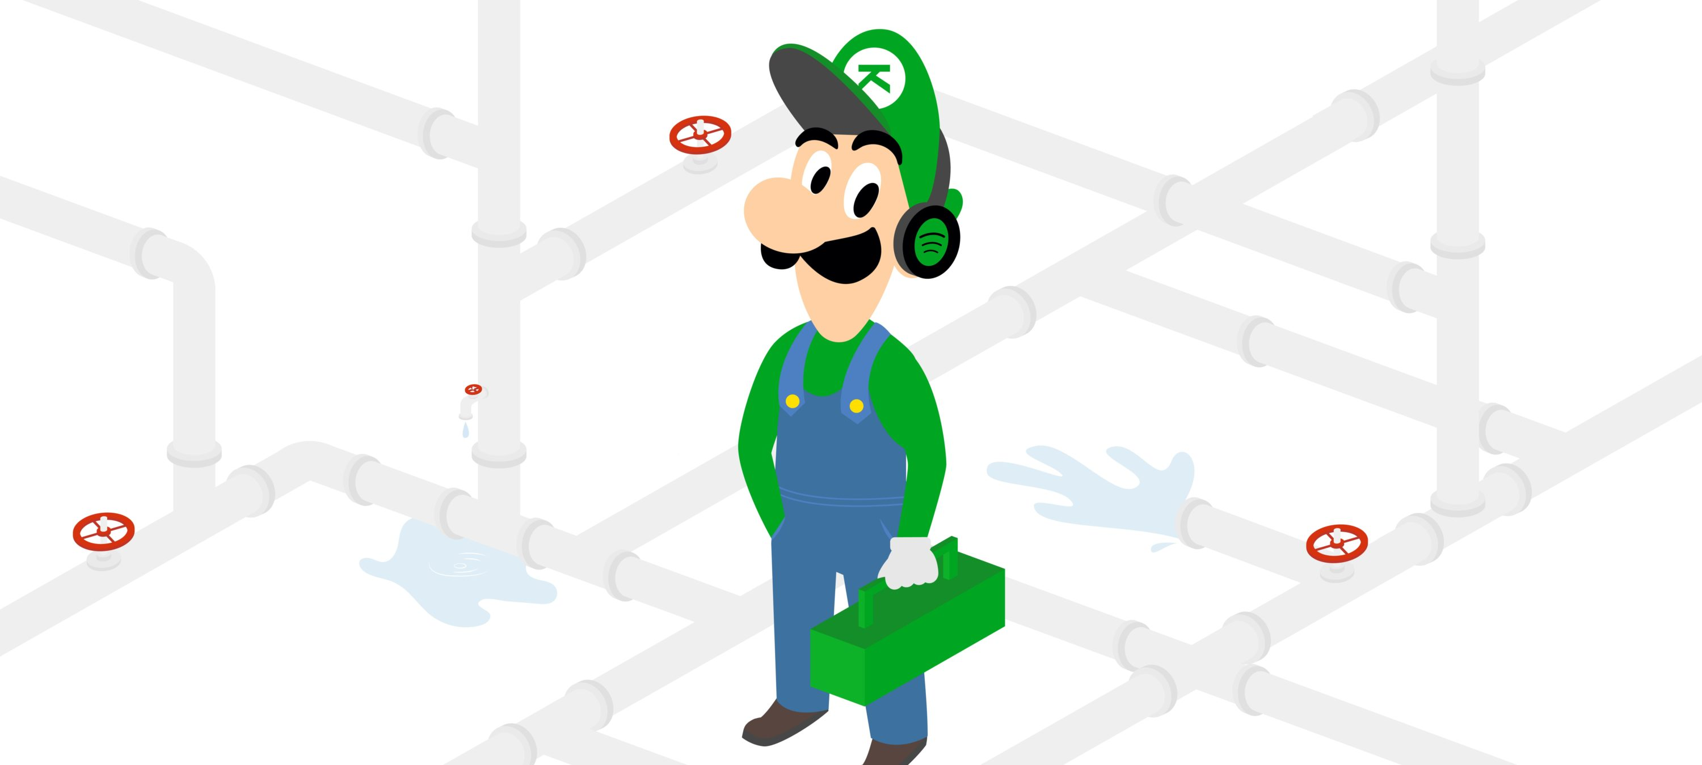
Walkthrough: using luigi to power a reporting pipeline
https://kapernikov.com/using-luigi-to-power-a-reporting-pipeline/

Slide 71
Defining the datasource
We will use the pandas package to import data into Python. If it's not installed, run pip install pandas in the command prompt. To load it, use import pandas as pd in your code.
Notes:
https://www.listendata.com/2017/12/python-pandas-tutorial.html
https://www.w3schools.com/python/pandas/pandas_dataframes.asp

Slide 72

Import CSV files
o import a CSV file into Python, we can use the read_csv( ) function from the pandas package. It is important to note that a singlebackslash does not work when specifying the file path. You need to either change it to forward slash or add one more backslash like below.
If no header (title) in raw data file
Notes:
https://www.listendata.com/2019/06/pandas-read-csv.html

Slide 73

Add Column Names
We can include column names by using names= option.
The variable names can also be added separately by using the following command.

Slide 74
Import File from URL
You don't need to perform additional steps to fetch data from URL. Simply put URL in the read_csv() function (applicable only for CSV files stored in URL).
Read sample of rows and columns
By specifying nrows= and usecols=, you can fetch specified number of rows and columns.
nrows = 5 implies you want to import only first 5 rows and usecols= refers to specified columns you want to import.

Slide 75

Skip rows while importing
Suppose you want to skip first 5 rows and wants to read data from 6th row (6th row would be a header row)
By including na_values= option, you can specify values as missing values. In this case, we are telling python to consider dot (.) as missing cases.

Slide 76
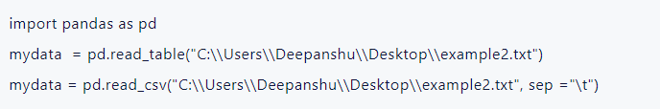
Read text file
We can use read_table() function to pull data from text file. We can also use read_csv() with sep= "\t" to read data from tab-separated file.

Slide 77
Read excel file
The read_excel() function can be used to import excel data into Python.
If you do not specify name of sheet in sheetname= option, it would take by default first sheet. The skiprows= option tells python to skip first N number of rows while importing data.

Slide 78


Read delimited file
Suppose you need to import a file that is separated with white spaces.
To include variable names, use the names= option like below -

Slide 79
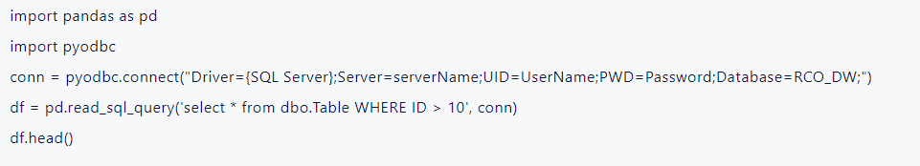
Import SQL Table
You can read data from tables stored in SQL Server by building a connection. You need to have server, User ID (UID), database details to establish connection.

Slide 80
Pandas exercises
https://www.w3resource.com/python-exercises/pandas/index-dataframe.php
Notes:
https://www.sqlalchemy.org/

Slide 81
aviationstack
https://aviationstack.com/
Notes:
import requests
params = {
'access_key': 'YOUR_ACCESS_KEY'
}
api_result = requests.get('https://api.aviationstack.com/v1/flights', params)
api_response = api_result.json()
for flight in api_response['results']:
if (flight['live']['is_ground'] is False):
print(u'%s flight %s from %s (%s) to %s (%s) is in the air.' % (
flight['airline']['name'],
flight['flight']['iata'],
flight['departure']['airport'],
flight['departure']['iata'],
flight['arrival']['airport'],
flight['arrival']['iata']))

Slide 82
Jupyter Notebooks in VS Code
Jupyter (formerly IPython Notebook) is an open-source project that lets you easily combine Markdown text and executable Python source code on one canvas called a notebook. Visual Studio Code supports working with Jupyter Notebooks natively, and through Python code files. This topic covers the native support available for Jupyter Notebooks and demonstrates how to:
Create, open, and save Jupyter Notebooks
Work with Jupyter code cells
View, inspect, and filter variables using the Variable Explorer and Data Viewer
Connect to a remote Jupyter server
Debug a Jupyter Notebook
Notes:
https://code.visualstudio.com/docs/datascience/jupyter-notebooks

Slide 83
Setting up your environment
To work with Python in Jupyter Notebooks, you must activate an Anaconda environment in VS Code, or another Python environment in which you've installed the Jupyter package. To select an environment, use the Python: Select Interpreter command from the Command Palette (Ctrl+Shift+P).
Once the appropriate environment is activated, you can create and open a Jupyter Notebook, connect to a remote Jupyter server for running code cells, and export a Jupyter Notebook as a Python file.

Slide 84
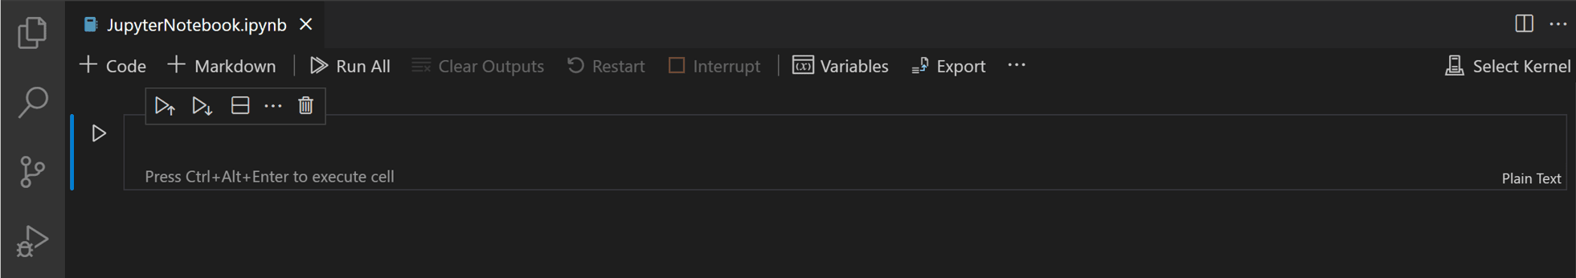
Create or open a Jupyter Notebook
You can create a Jupyter Notebook by running the Create: New Jupyter Notebook command from the Command Palette (Ctrl+Shift+P) or by creating a new .ipynb file in your workspace.
Next, select a kernel using the kernel picker in the top right.

Slide 85
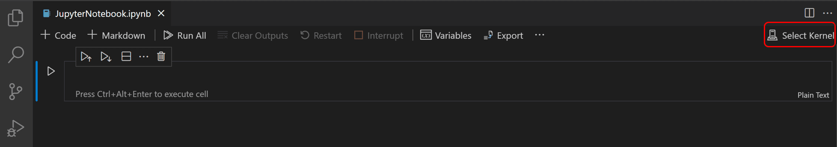
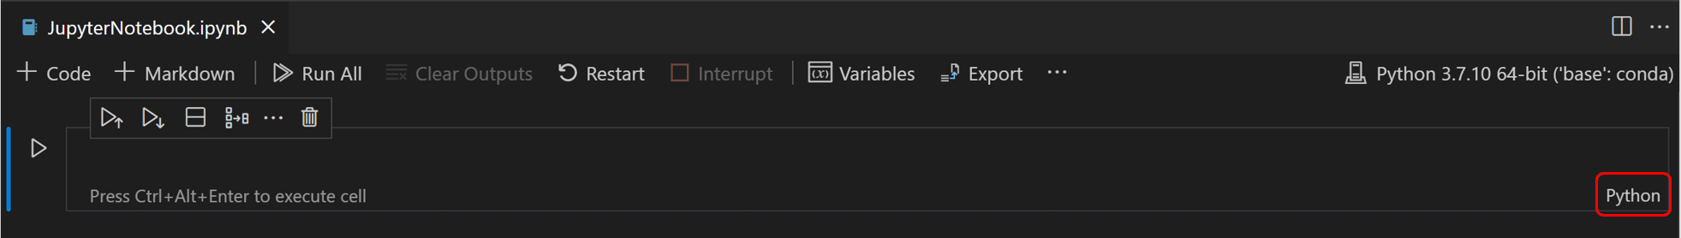
After selecting a kernel, the language picker located in the bottom right of each code cell will automatically update to the language supported by the kernel.
If you have an existing Jupyter Notebook, you can open it by right-clicking on the file and opening with VS Code, or through the VS Code File Explorer.

Slide 86
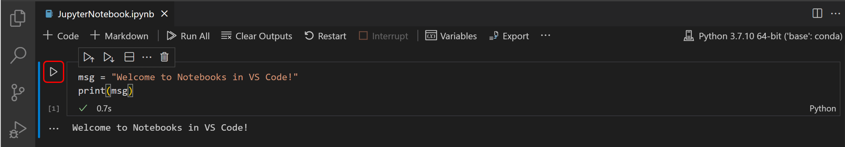
Running cells
Once you have a notebook, you can run a code cell using the Run icon to the left of the cell and the output will appear directly below the code cell.
To run code, you can also use keyboard shortcuts in both command and edit mode. To run the current cell, use Ctrl+Enter. To run the current cell and advance to the next, use Shift+Enter.

Slide 87
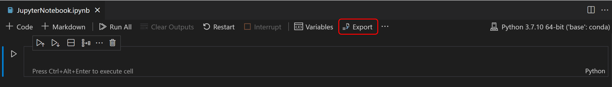
Export your Jupyter Notebook
You can export a Jupyter Notebook as a Python file (.py), a PDF, or an HTML file. To export, select the Export action on the main toolbar. You'll then be presented with a dropdown of file format options.
Note: For PDF export, you must have TeX installed. If you don't, you will be notified that you need to install it when you select the PDF option. Also, be aware that if you have SVG-only output in your Notebook, they will not be displayed in the PDF. To have SVG graphics in a PDF, either ensure that your output includes a non-SVG image format or else you can first export to HTML and then save as PDF using your browser.

Slide 88
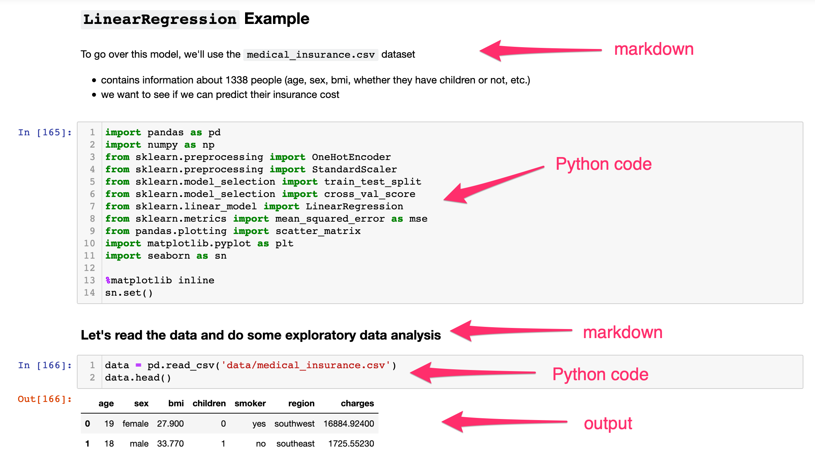
markdown
Notes:
https://www.edlitera.com/blog/posts/jupyter-markdown-tutorial

Slide 89
Variable Explorer and Data Viewer
Within a Python Notebook, it's possible to view, inspect, sort, and filter the variables within your current Jupyter session. By selecting the Variables icon in the main toolbar after running code and cells, you'll see a list of the current variables, which will automatically update as variables are used in code. The variables pane will open at the bottom of the notebook.

Slide 90
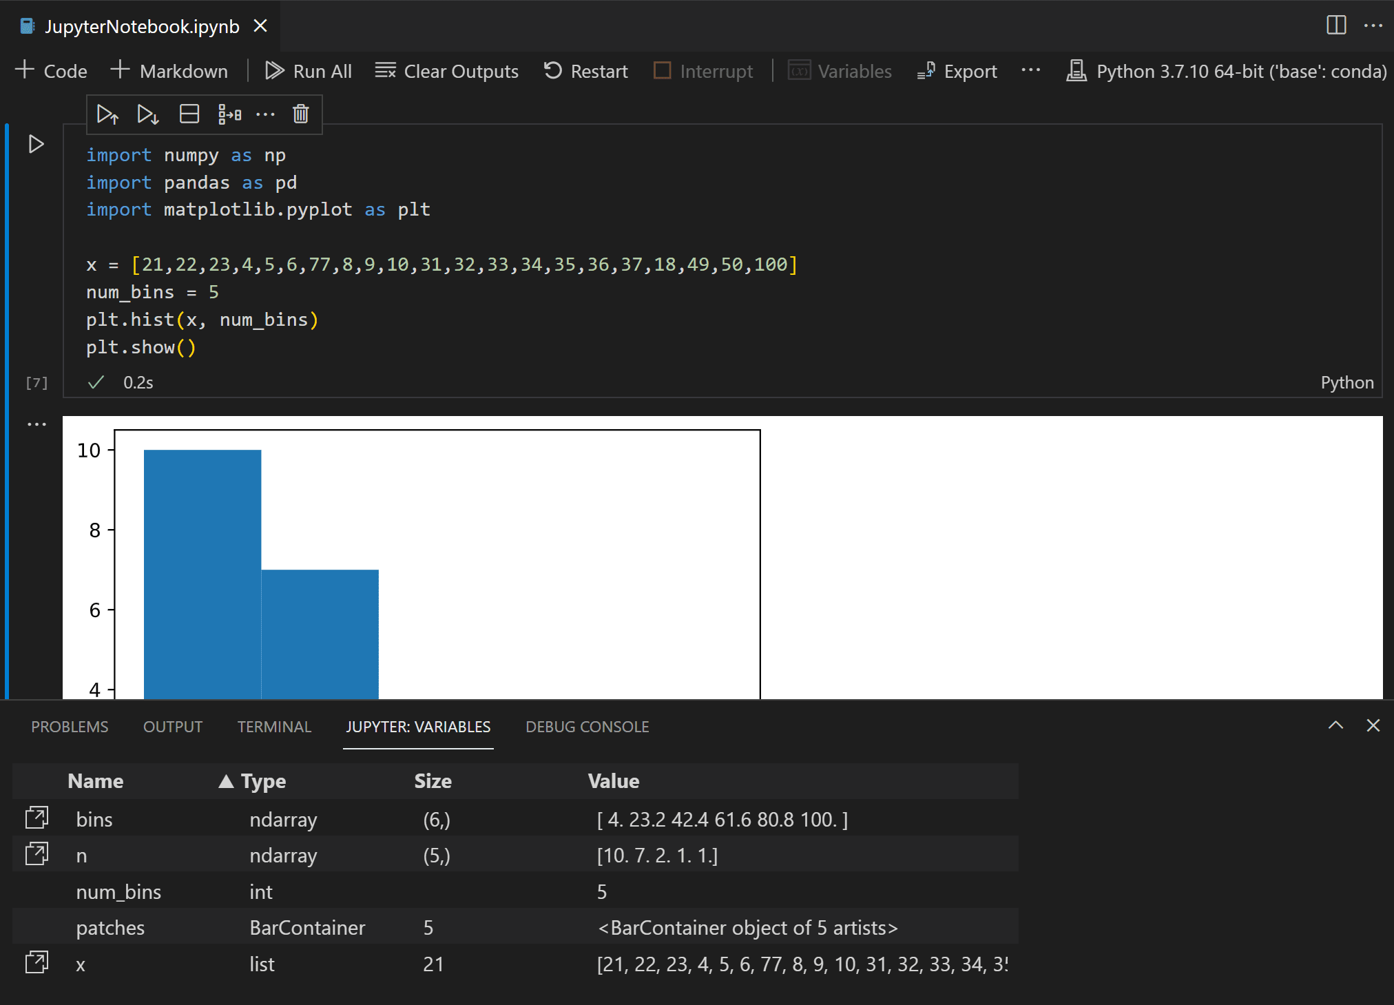

Slide 91
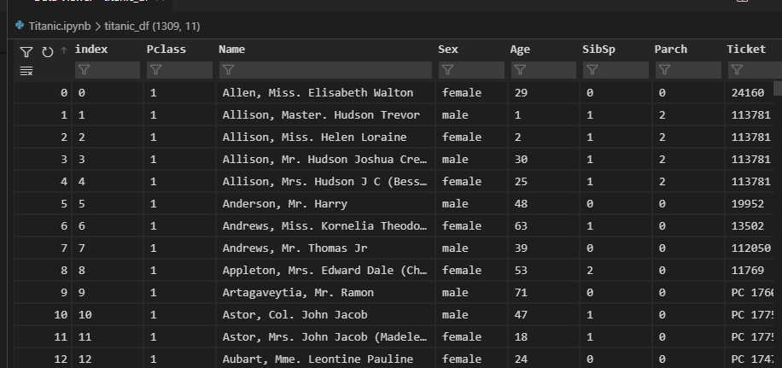
Data Viewer
For additional information about your variables, you can also double-click a row or use the Show variable in data viewer button next to the variable for a more detailed view of a variable in the Data Viewer.

Slide 94
Clean and validate

Slide 95
What Is Data Cleaning?
When working with multiple data sources, there are many chances for data to be incorrect, duplicated, or mislabeled. If data is wrong, outcomes and algorithms are unreliable, even though they may look correct. Data cleaning is the process of changing or eliminating garbage, incorrect, duplicate, corrupted, or incomplete data in a dataset. There’s no such absolute way to describe the precise steps in the data cleaning process because the processes may vary from dataset to dataset. Data cleansing, data cleansing, or data scrub is the general data preparation process initiative. Data cleaning plays an important part in developing reliable answers within the analytical process and is observed to be a basic feature of the info science basics. The motive of data cleaning services is to construct uniform and standardized data sets that enable easy access to data analytics tools and business intelligence and perceive accurate data for each problem.
Notes:
https://www.analyticsvidhya.com/blog/2021/06/data-cleaning-using-pandas/

Slide 96
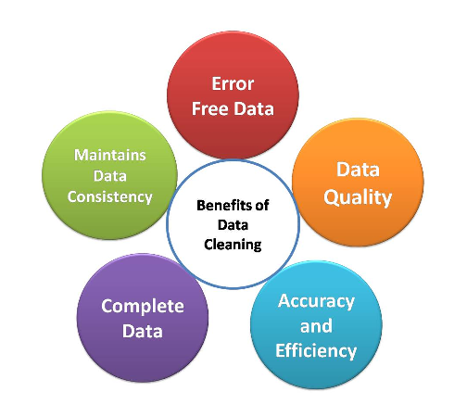
Why Is Data Cleaning Essential?
Data cleaning is the most important task that should be done by a data science professional. Having wrong or bad-quality data can be detrimental to processes and analysis. Having clean data will ultimately increase overall productivity and permit the very best quality information in your decision-making.

Slide 97
Error-Free Data
When multiple sources of data are combined, there may be a chance of so much error. Through Data Cleaning, errors can be removed from data.
Having clean data which is free from wrong and garbage values can help in performing analysis faster as well as efficiently. By doing this task our considerable amount of time is saved.
The results won’t be accurate if we use data containing garbage values. When we don’t use accurate data, we will surely make mistakes. Monitoring errors and good reporting helps to find where errors are coming from and also makes it easier to fix incorrect or corrupt data for future applications.

Slide 98
Data Quality
The quality of the data is the degree to which it follows the rules of particular requirements.
For example, if we have imported phone numbers data of different customers, and in some places, we have added email addresses of customers in the data. But because our needs were straightforward for phone numbers, then the email addresses would be invalid data. Here some pieces of data follow a specific format. Some types of numbers have to be in a specific range. Some data cells might require selected quiet data like numeric, Boolean, etc. In every scenario, there are some mandatory constraints our data should follow. Certain conditions affect multiple fields of data in a particular form. Particular types of data have unique restrictions. It will always be invalid if the data isn’t in the required format. Data cleaning will help us simplify this process and avoid useless data values.

Slide 99
Accurate and Efficient
Ensuring the data is close to the correct values. We know that most of the data in a dataset are valid, and we should focus on establishing its accuracy. Even if the data is authentic and correct, it doesn’t mean it is accurate.
Determining accuracy helps to figure out whether the data entered is accurate or not. For example, a customer’s address is stored in the specified format; maybe it doesn’t need to be in the right one. The email has an additional character or value that makes it incorrect or invalid.
Another example is the phone number of a customer. This means that we have to rely on data sources to cross-check the data to figure out if it’s accurate or not. Depending on the kind of data we are using, we might be able to find various resources that could help us in this regard for cleaning.

Slide 100
Complete Data
Completeness is the degree to which we should know all the required values. Completeness is a little more challenging to achieve than accuracy or quality. Because it’s nearly impossible to have all the info we need, only known facts can be entered.
We can try to complete data by redoing the data-gathering activities like approaching the clients again, re-interviewing people, etc. For example, we might need to enter every customer’s contact information. But a number of them might not have email addresses. In this case, we have to leave those columns empty.
If we have a system that requires us to fill all columns, we can try to enter missing or unknown there. But entering such values does not mean that the data is complete. It would still be referred to as incomplete.

Slide 101
Maintains Data Consistency
To ensure the data is consistent within the same dataset or across multiple datasets, we can measure consistency by comparing two similar systems. We can also check the data values within the same dataset to see if they are consistent or not. Consistency can be relational. For example, a customer’s age might be 25, which is a valid value and also accurate, but it is also stated as a senior citizen in the same system. In such cases, we have to cross-check the data, similar to measuring accuracy, and see which value is true. Is the client a 25-year-old? Or is the client a senior citizen? Only one of these values can be true. There are multiple ways to for your data consistent.
By checking in different systems.
By checking the source.
By checking the latest data.

Slide 102
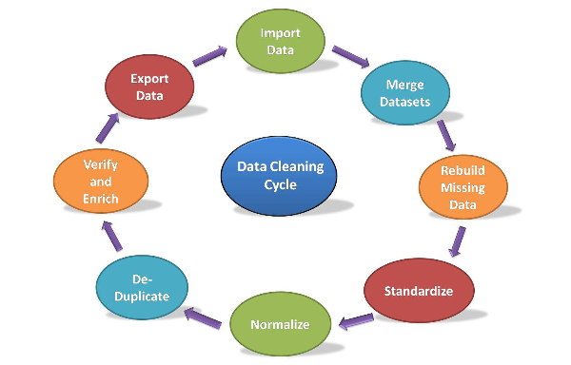
Data Cleaning Cycle
It is the method of analyzing, distinguishing, and correcting untidy, raw data. Data cleaning involves filling in missing values, handling outliers, and distinguishing and fixing errors present in the dataset.
Whereas the techniques used for data cleaning might vary in step with different types of datasets. In this tutorial, we will learn how to clean data using pandas. The following are standard steps to map out data cleaning:

Slide 103
Data Cleaning With Pandas
Data scientists spend a huge amount of time cleaning datasets and getting them in the form in which they can work. It is an essential skill of Data Scientists to be able to work with messy data, missing values, and inconsistent, noisy, or nonsensical data.
To work smoothly, python provides a built-in module, Pandas. Pandas is the popular Python library that is mainly used for data processing purposes like cleaning, manipulation, and analysis.
Pandas stand for “Python Data Analysis Library”. It consists of classes to read, process, and write csv files. There are numerous Data cleaning tools present, but the Pandas library provides a really fast and efficient way to manage and explore data. It does that by providing us with Series and DataFrames, which help us represent data efficiently and manipulate it in various ways.

Slide 104
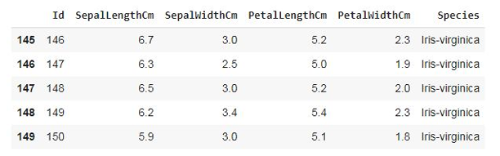
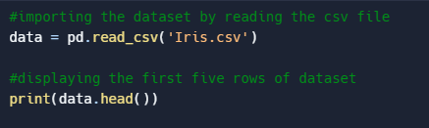

Step 1: Import Dataset
To import the dataset, we use the read_csv() function of pandas and store it in the pandas DataFrame named as data. As the dataset is in tabular format, when working with tabular data in Pandas, it will be automatically converted into a DataFrame. DataFrame is a two-dimensional, mutable data structure in Python. It is a combination of rows and columns like an excel sheet.
The head() function is a built-in function in pandas for the dataframe used to display the rows of the dataset. We can specify the number of rows by giving the number within the parenthesis. By default, it displays the first five rows of the dataset. If we want to see the last five rows of the dataset, we use the tail()function of the dataframe like this:
Notes:
http://kaggle.com/

Slide 105
Step 2: Merge Dataset
Merging the dataset is the process of combining two datasets in one and lining up rows based on some particular or common property for data analysis. We can do this by using the merge() function of the dataframe. Following is the syntax of the merge function:
DataFrame_name.merge(right, how='inner', on=None, left_on=None, right_on=None, left_index=False, right_index=False, sort=False, suffixes=('_x', '_y'), copy=True, indicator=False, validate=None)
Notes:
https://pandas.pydata.org/pandas-docs/stable/reference/api/pandas.DataFrame.merge.html

Slide 106
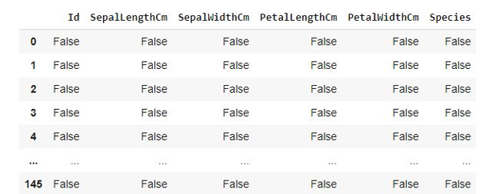
Step 3: Rebuild Missing Data
To find and fill in the missing data in the dataset, we will use another function. There are 4 ways to find the null values if present in the dataset. Let’s see them one by one:
Using isnull() function:
Using isna() function:

Slide 107
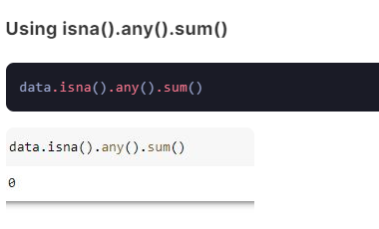
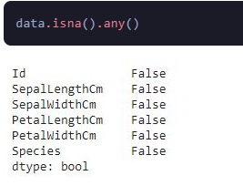
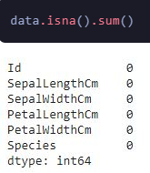
Using isna().any()
Using isna(). sum()

Slide 108
There are no null values present in our dataset. But if there are any null values preset, we can fill those places with any other value using the fillna() function of DataFrame.Following is the syntax of fillna() function:
DataFrame_name.fillna(value=None, method=None, axis=None, inplace=False, limit=None, downcast=None)
This function will fill NA/NaN or 0 values in place of null spaces. You may also drop null values using the dropna method when the amount of missing data is relatively small and unlikely to affect the overall.
Notes:
https://pandas.pydata.org/pandas-docs/stable/reference/api/pandas.DataFrame.fillna.html

Slide 109
Step 4: Standardization and Normalization
Data Standardization and Normalization is a common practices in machine learning.
Standardization is another scaling technique where the values are centered around the mean with a unit standard deviation. This means that the mean of the attribute becomes zero, and the resultant distribution has a unit standard deviation.
Normalization is a scaling technique in which values are shifted and rescaled so that they end up ranging between 0 and 1. It is also known as Min-Max scaling.
Notes:
https://www.analyticsvidhya.com/blog/2020/04/feature-scaling-machine-learning-normalization-standardization/

Slide 110
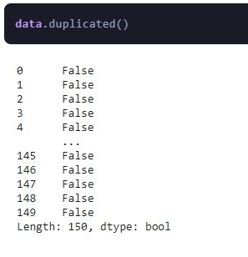
Step 5: De-Duplicate Data
De-Duplicate means removing all duplicate values. There is no need for duplicate values in data analysis. These values only affect the accuracy and efficiency of the analysis result. To find duplicate values in the dataset, we will use a simple dataframe function, i.e., duplicated(). Let’s see the example:

Slide 111
This function also provides bool values for duplicate values in the dataset. As we can see, the dataset doesn’t contain any duplicate values. If a dataset contains duplicate values, it can be removed using the drop_duplicates() function. Following is the syntax of this function:
DataFrame_name.drop_duplicates(subset=None, keep='first', inplace=False, ignore_index=False)
Notes:
https://pandas.pydata.org/docs/reference/api/pandas.DataFrame.drop_duplicates.html

Slide 112
Step 6: Verify and Enrich the Data
After removing null, duplicate, and incorrect values, we should verify the dataset and validate its accuracy. In this step, we have to check that the data cleaned so far is making any sense. If the data is incomplete, we have to enrich the data again by data gathering activities like approaching the clients again, re-interviewing people, etc. Completeness is a little more challenging to achieve accuracy or quality in the dataset.

Slide 113
Step 7: Export Dataset
This is the last step of the data-cleaning process. After performing all the above operations, the data is transformed into a clean dataset, and it is ready to export for the next process in Data Science or Data Analysis.

Slide 114
kaggle
Significant Earthquakes, 1965-2016
https://www.kaggle.com/datasets/usgs/earthquake-database

Slide 115
Google Geocoding
https://developers.google.com/maps/documentation/geocoding/get-api-key#console
https://www.geonames.org/
http://api.geonames.org/countryCodeJSON?lat=49.03&lng=10.2&username=pbtraining

Slide 116
regexp
Notes:
https://luigi.readthedocs.io/en/stable/execution_model.html#triggering-tasks
https://pypi.org/project/python-crontab/

Slide 117
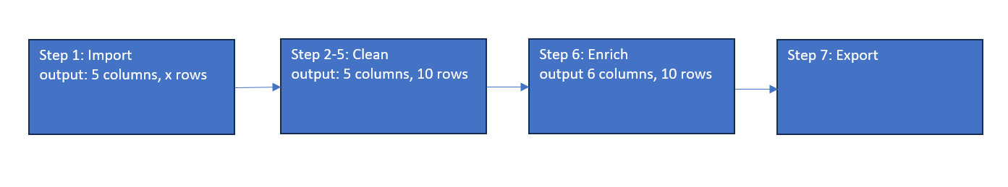
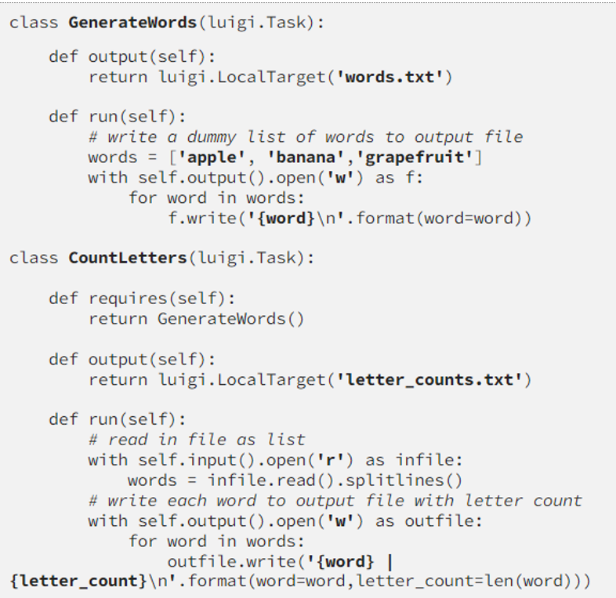
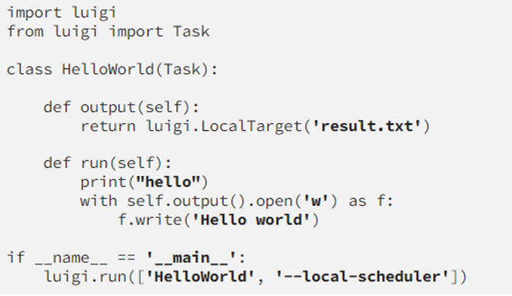
LUIGI

Slide 118
Luigi parameters
Parameters is the Luigi equivalent of creating a constructor for each Task. Luigi requires you to declare these parameters by instantiating Parameter objects on the class scope:
class DailyReport(luigi.contrib.hadoop.JobTask):
date = luigi.DateParameter(default=datetime.date.today())
# ...
By doing this, Luigi can take care of all the boilerplate code that would normally be needed in the constructor. Internally, the DailyReport object can now be constructed by running DailyReport(datetime.date(2012, 5, 10)) or just DailyReport(). Luigi also creates a command line parser that automatically handles the conversion from strings to Python types. This way you can invoke the job on the command line eg. by passing --date 2012-05-10.

Slide 119
The parameters are all set to their values on the Task object instance, i.e.
d = DailyReport(datetime.date(2012, 5, 10))
print(d.date)
will return the same date that the object was constructed with. Same goes if you invoke Luigi on the command line.

Slide 120
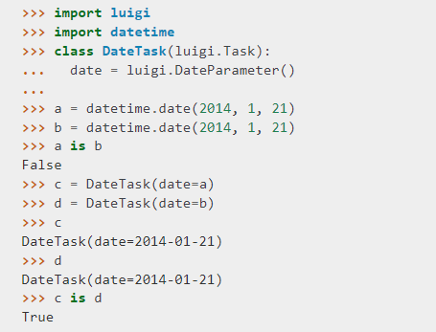
Instance caching
Tasks are uniquely identified by their class name and values of their parameters. In fact, within the same worker, two tasks of the same class with parameters of the same values are not just equal, but the same instance:

Slide 122
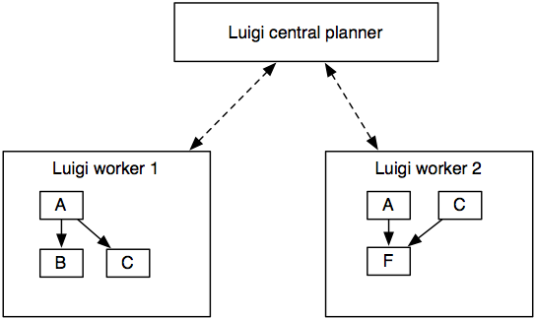
Luigi execution model
The most important aspect is that no execution is transferred. When you run a Luigi workflow, the worker schedules all tasks, and also executes the tasks within the process.

Slide 123
Luigi scheduling
The benefit of this scheme is that it’s super easy to debug since all execution takes place in the process. It also makes deployment a non-event. During development, you typically run the Luigi workflow from the command line, whereas when you deploy it, you can trigger it using crontab or any other scheduler.
The downside is that Luigi doesn’t give you scalability for free. In practice this is not a problem until you start running thousands of tasks.
Isn’t the point of Luigi to automate and schedule these workflows? To some extent. Luigi helps you encode the dependencies of tasks and build up chains. Furthermore, Luigi’s scheduler makes sure that there’s a centralized view of the dependency graph and that the same job will not be executed by multiple workers simultaneously.

Slide 124
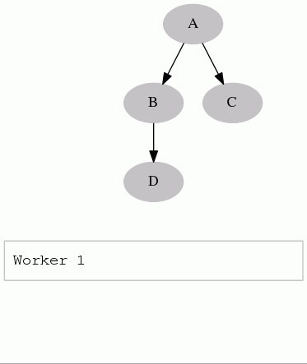
A client only starts the run() method of a task when the single-threaded central scheduler has permitted it. Since the number of tasks is usually very small (in comparison with the petabytes of data one task is processing), we can afford the convenience of a simple centralised server.

Slide 125
triggering
Luigi does not include its own triggering, so you have to rely on an external scheduler such as crontab to actually trigger the workflows.
In practice, it’s not a big hurdle because Luigi avoids all the mess typically caused by it. Scheduling a complex workflow is fairly trivial using eg. crontab.
In the future, Luigi might implement its own triggering. The dependency on crontab (or any external triggering mechanism) is a bit awkward and it would be nice to avoid.

Slide 126
Trigger example
For instance, if you have an external data dump that arrives every day and that your workflow depends on it, you write a workflow that depends on this data dump. Crontab can then trigger this workflow every minute to check if the data has arrived. If it has, it will run the full dependency graph.

Slide 127
# my_tasks.py
class DataDump(luigi.ExternalTask):
date = luigi.DateParameter()
def output(self): return luigi.contrib.hdfs.HdfsTarget(self.date.strftime('/var/log/dump/%Y-%m-%d.txt'))
class AggregationTask(luigi.Task):
date = luigi.DateParameter()
window = luigi.IntParameter()
def requires(self): return [DataDump(self.date - datetime.timedelta(i)) for i in xrange(self.window)]
def run(self): run_some_cool_stuff(self.input())
def output(self): return luigi.contrib.hdfs.HdfsTarget('/aggregated-%s-%d' % (self.date, self.window))
class RunAll(luigi.Task):
''' Dummy task that triggers execution of a other tasks'''
def requires(self):
for window in [3, 7, 14]:
for d in xrange(10): # guarantee that aggregations were run for the past 10 days
yield AggregationTask(datetime.date.today() - datetime.timedelta(d), window)

Slide 128
In your cronline you would then have something like
30 0 * * * my-user luigi RunAll --module my_tasks
You can trigger this as much as you want from crontab, and even across multiple machines, because the central scheduler will make sure at most one of each AggregationTask task is run simultaneously. Note that this might actually mean multiple tasks can be run because there are instances with different parameters, and this can give you some form of parallelization (eg. AggregationTask(2013-01-09) might run in parallel with AggregationTask(2013-01-08)).
Of course, some Task types (eg. HadoopJobTask) can transfer execution to other places, but this is up to each Task to define.

Slide 130
https://www.projectpro.io/article/apache-airflow-dags/848#:~:text=The%20DAGs%20folder%20is%20specified,in%20the%20Airflow%20web%20UI.
https://learn.microsoft.com/en-us/azure/azure-sql/database/azure-sql-python-quickstart?view=azuresql&tabs=windows%2Csql-inter

